Slide 1
14.5
Directional Derivatives and Gradient Vectors
Copyright © 2010 Pearson Education, Inc. Publishing as Pearson Addison-Wesley

Slide 2
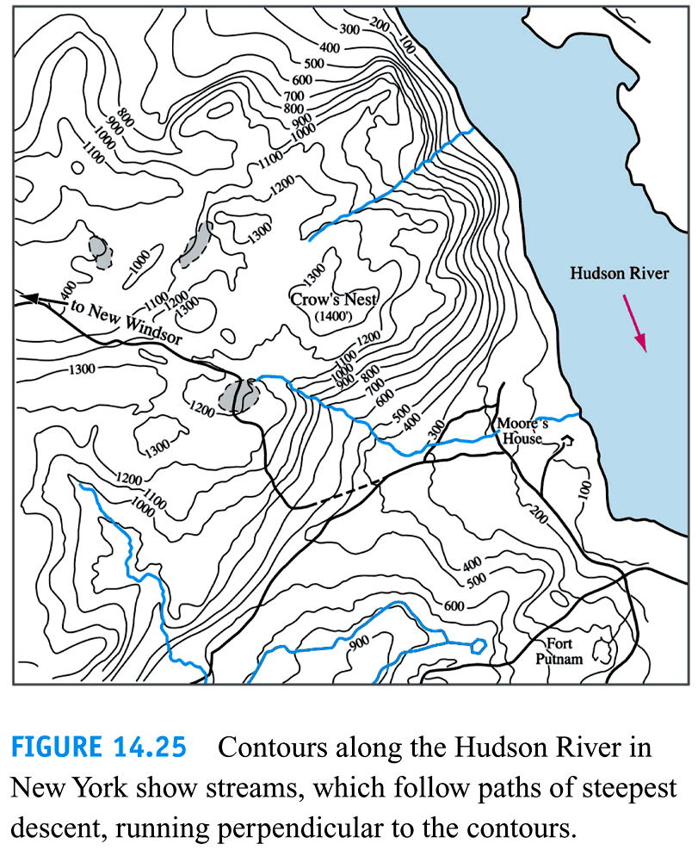

Slide 3
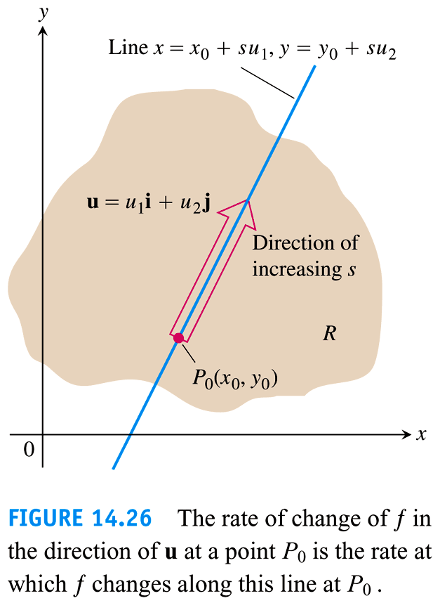

Slide 4


Slide 5
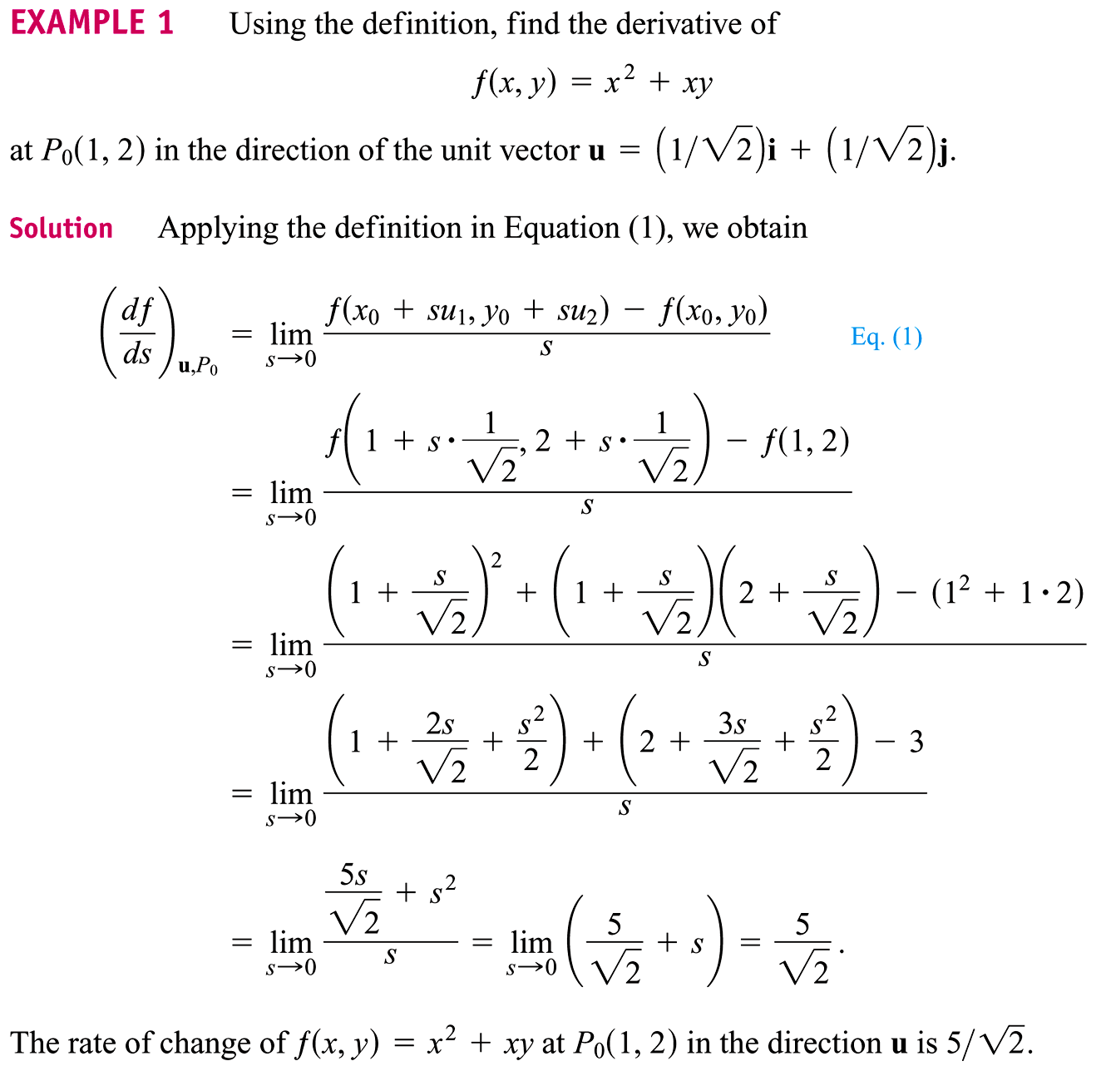

Slide 6
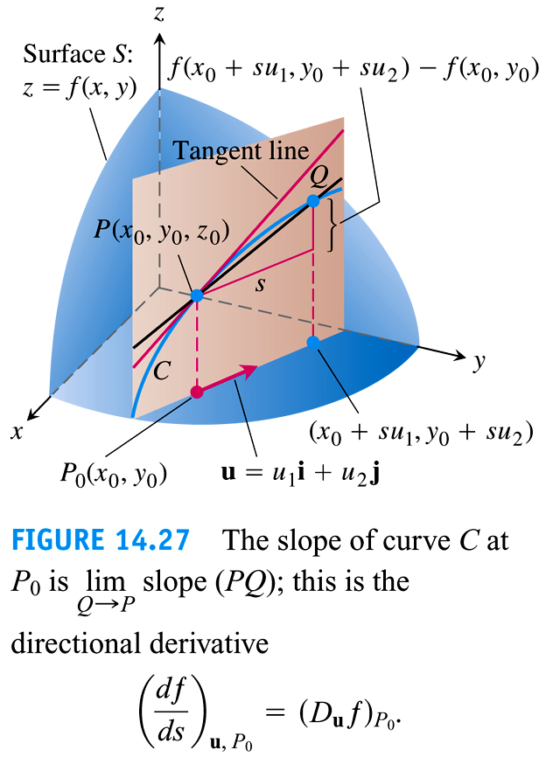

Slide 7


Slide 8


Slide 9
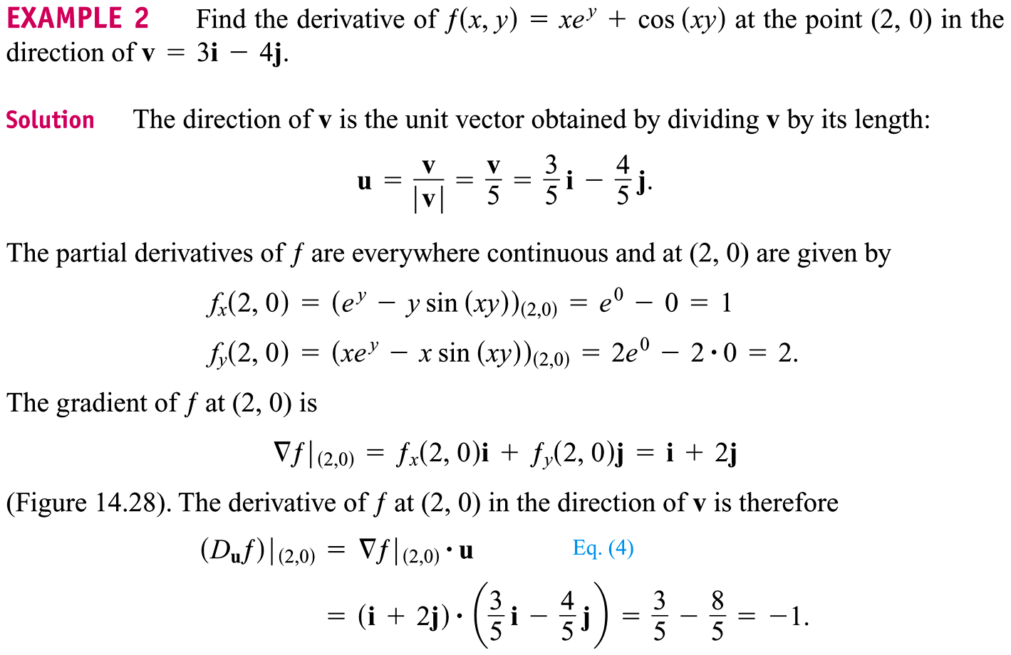

Slide 10
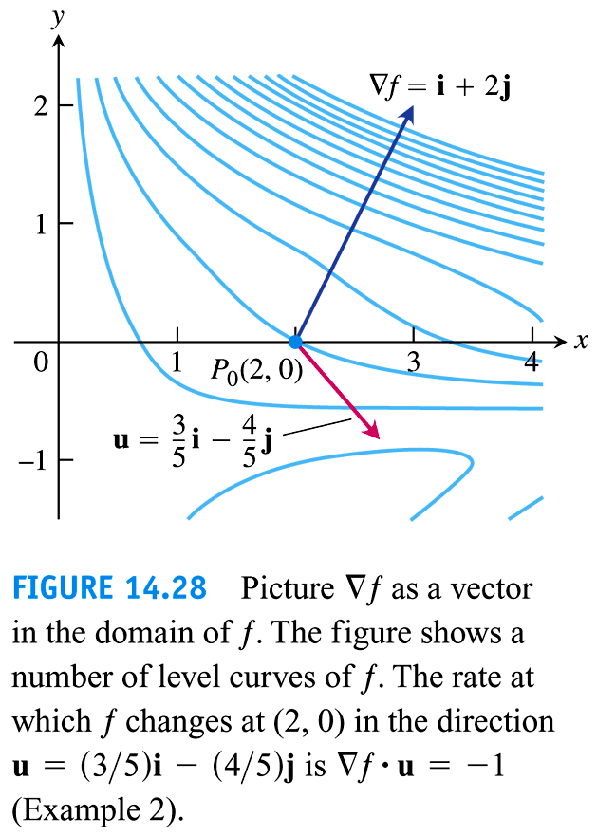

Slide 11
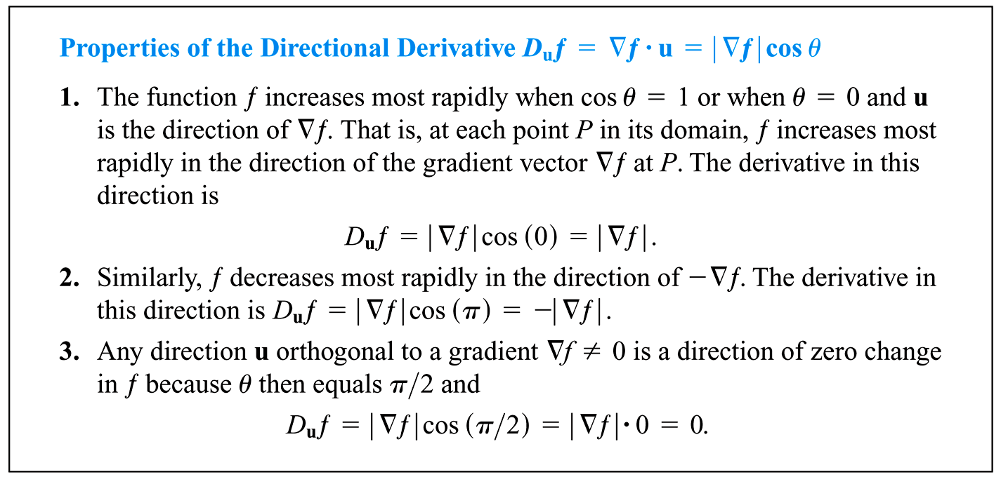

Slide 12
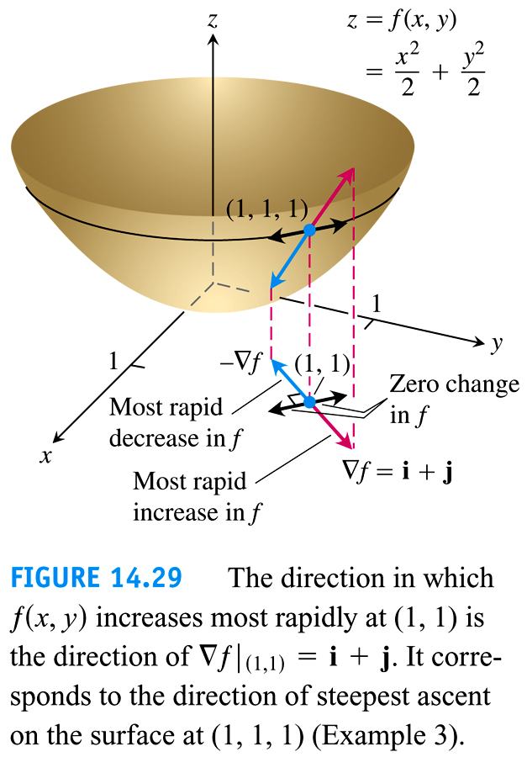

Slide 13
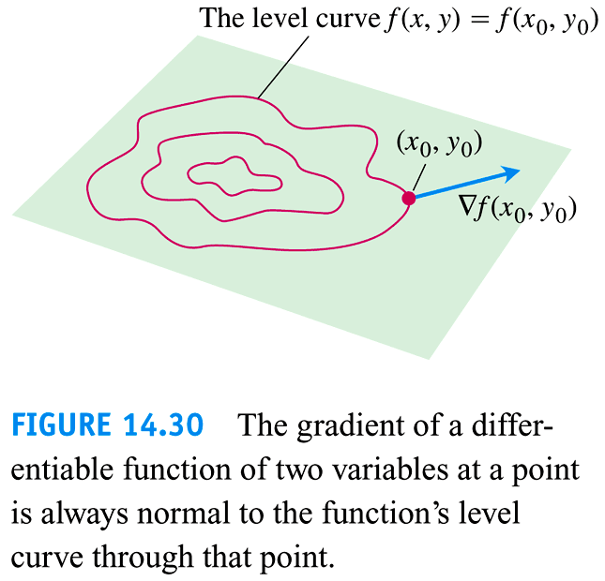

Slide 14


Slide 15
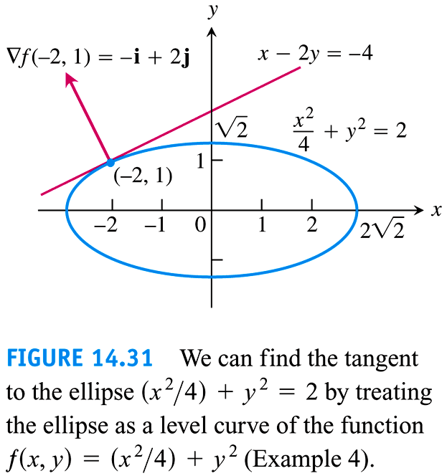

Slide 16
